Slide 1
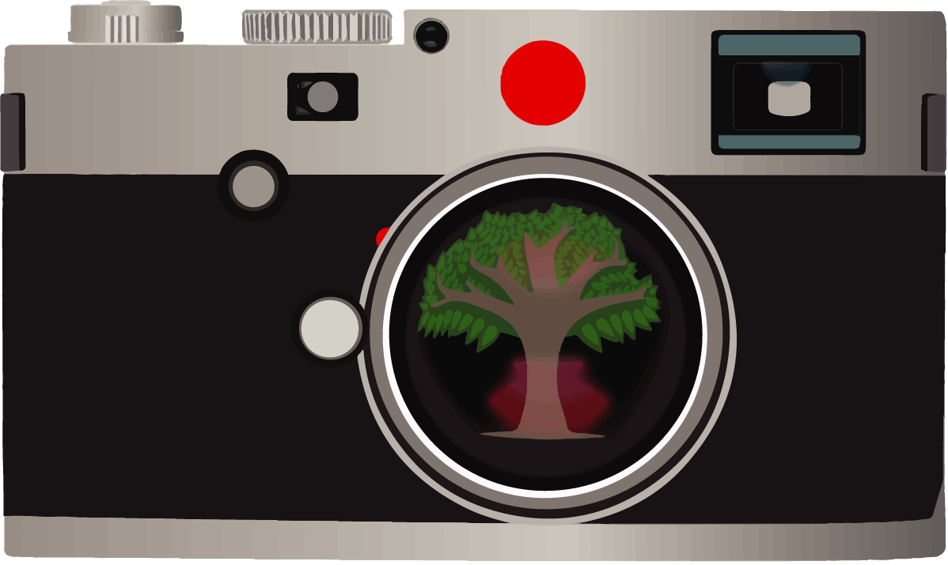
Picturing Resilience Intervention:
Using Photovoice for Youth Resilience

Slide 2
PRI Examples:
Individual Strengths and
Community Resources
“Safe Place”
This is a safe place for people and we have to be safe around other people. This way no one will get hurt and won’t be in danger. This photo says that a safe place is important to our lives.

Slide 3
PRI Examples:
Individual Strengths and
Community Resources
“Basketball”
I took a photograph of a basketball because basketball is my favorite sport. I have my own basketball. I practice a lot so that I can get better. You just have to shoot the ball.

Slide 4
PRI Examples:
Individual Strengths and
Community Resources
“Joyful Flowers”
Here we see a photograph of colorful flowers. It makes me feel great about the world because flowers are beautiful. I like flowers because they can make people happy. When I am sad, I pick up flowers and it makes my whole day better. I can pick flowers and share them with sad people and share the joy of flowers. Through flowers, we can show people what Mother Nature does for us.

Slide 5
PRI Examples:
Individual Strengths and
Community Resources
“Playground”
Here is a nice swing set but no one is playing. We need to be more active and help kids to get outside and play.

Slide 6
PRI Examples:
Individual Strengths and
Community Resources
“Meme”
This is a photograph of my dog, Meme. She and I are playing. I took this picture to remember her because she is my favorite dog. She is very sweet and playful. You will love to play with her because she is the most “playfulist” dog you know.

Slide 7
PRI Examples:
Individual Strengths and
Community Resources
“Caps and Bats”
This is a picture of my team’s caps and my bats. This is my stuff. I play baseball. It is important to try and play sports. I would like to help people play sports.

Slide 8
PRI Examples:
Individual Strengths and
Community Resources
“Tornado Shelter”
This is a picture of a tornado shelter and grass. A shelter like this keeps you safe from tornadoes and could save your life.

Slide 9
PRI Examples:
Individual Strengths and
Community Resources
“Church”
This is a photograph of a church. People can learn about what is good and what is not good when they go to church. We can educate people to go to church more and this will help people from doing wrong.
*All example photos and narratives courtesy of former PRI participants.

